Slide 1
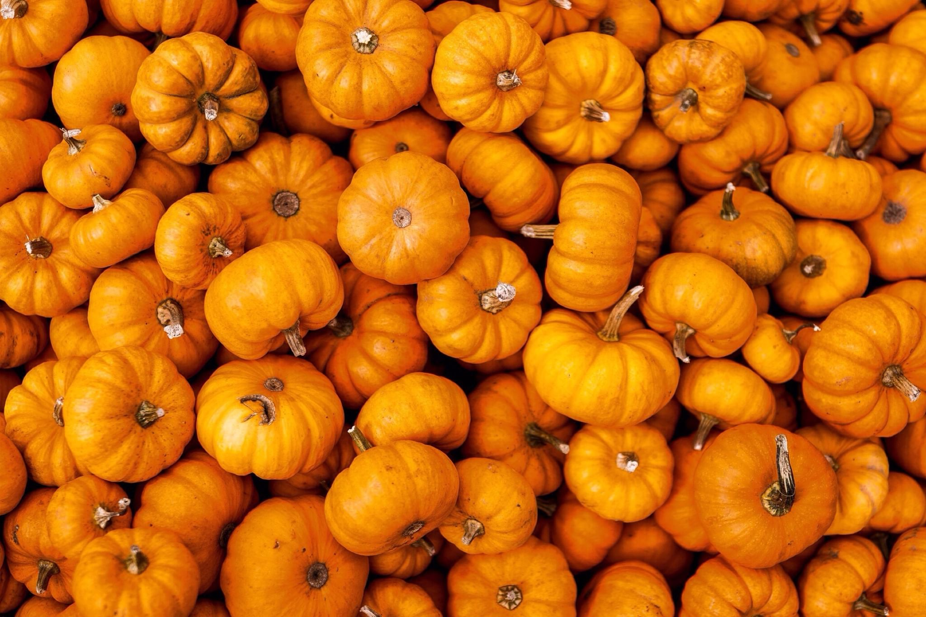
little investigation based on
Big
Pumpkins
Dataset
by Алёна Зенина & Анна Кученина

Slide 2
Hypothesis
Weight of pumpkins varies depending on region of growth: as a plant, pumpkin is likely to grow better in hot conditions
Pumpkins are bigger closer to equator?

Slide 3
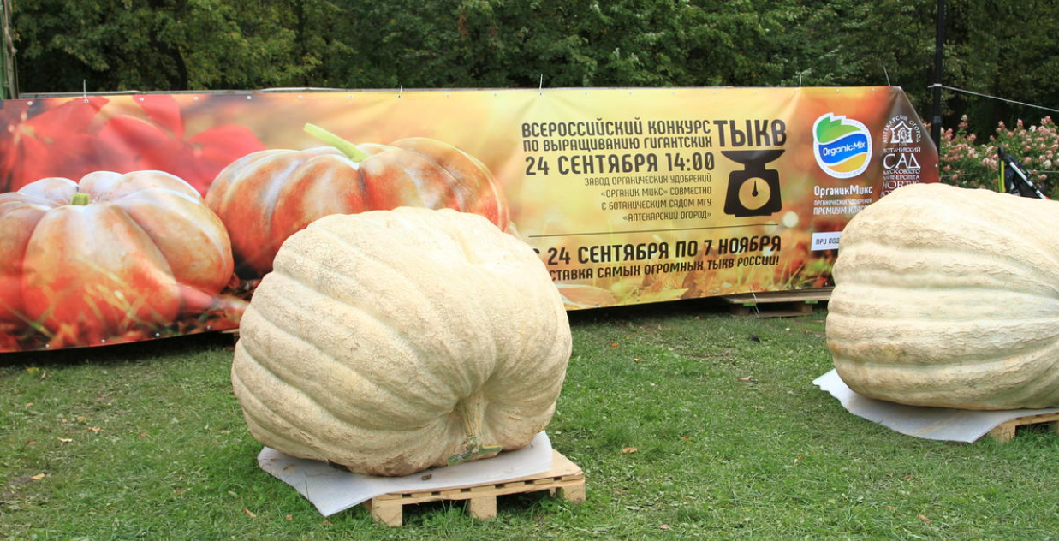

Slide 4
Used data
dataset on Giant Pumpkins
datasets on cities’ geographical locations

Slide 5
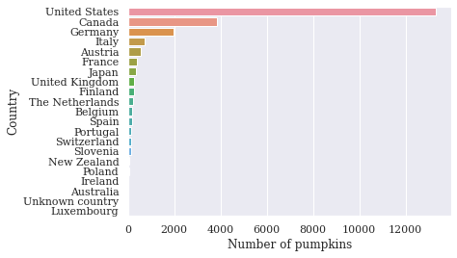
General info

Slide 6
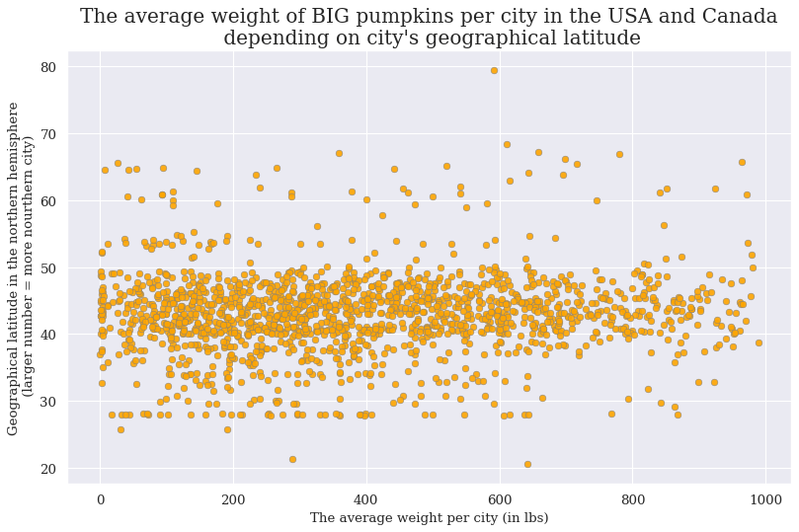

Slide 7
expected direction of regression

